Slide 1
TEAM RYMSS
Project for operations with mathematical sets

Slide 2

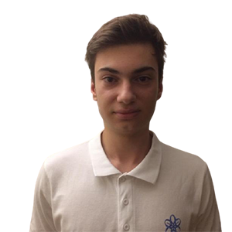
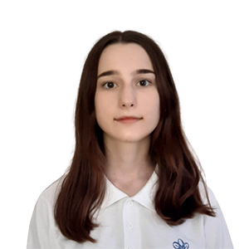
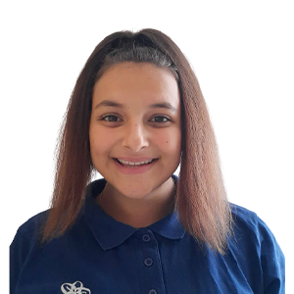
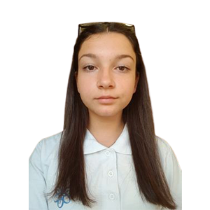
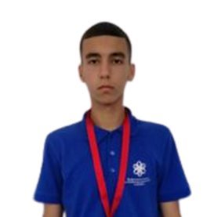
Our team
Stefan Ganchev X^{B}
Yoana Stoyanova X^{V}
Radina Velichkova X^{V}
Magdalena Omayska X^{V}
Stanislav Todorov X^{B}

Slide 3






Stages of realization

Slide 4
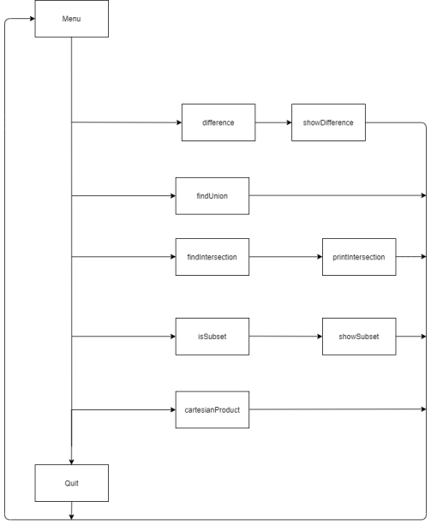
DIAGRAM FOR OUR PROGRAM

Slide 5

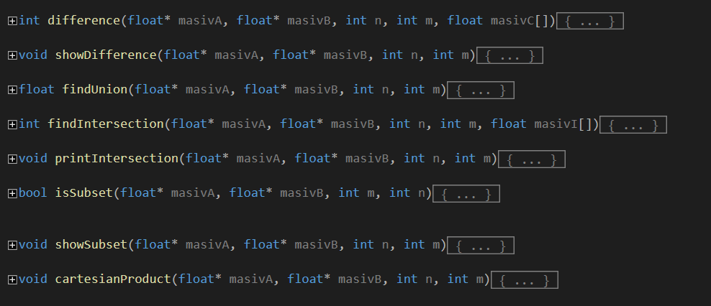
The functions and files that we used

Slide 6






USED TECHNOLOGIES

Slide 7

Now it's time for our program

Slide 8


Slide 9
Thank you for your ATTENTION!

